Slide 1
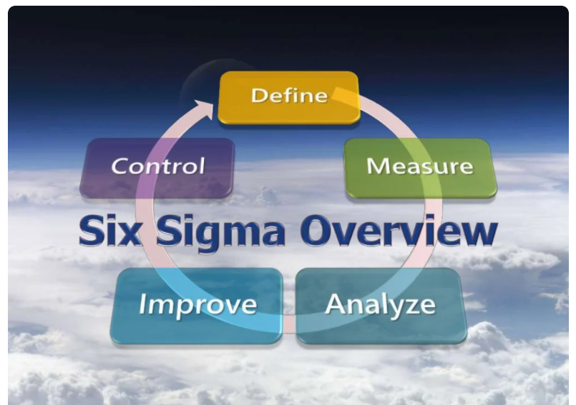

Slide 2
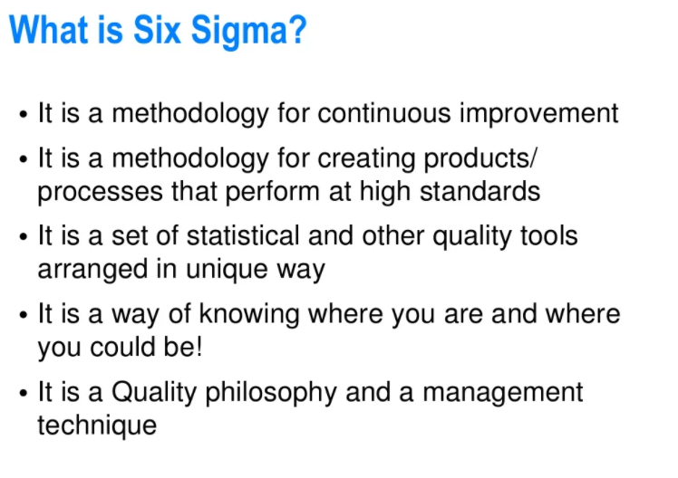

Slide 3
Definitions
σ – Standard Deviation, a measure of variability
Six Sigma – A quality improvement philosophy that focuses on eliminating defects through reduction of variation in a process
Defect – A measurable outcome that is not within acceptable (specification) limits

Slide 4
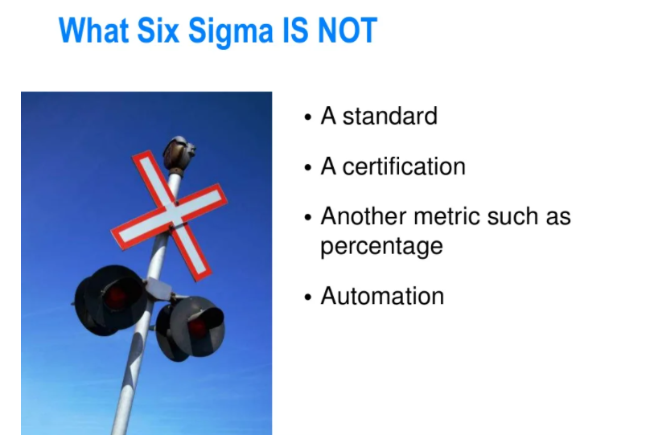

Slide 5
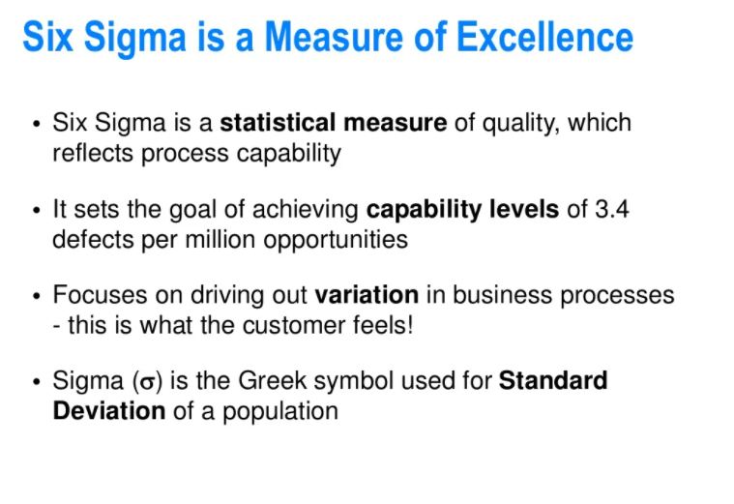

Slide 6
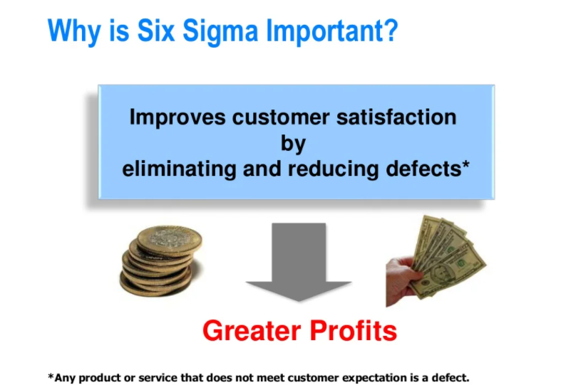

Slide 7
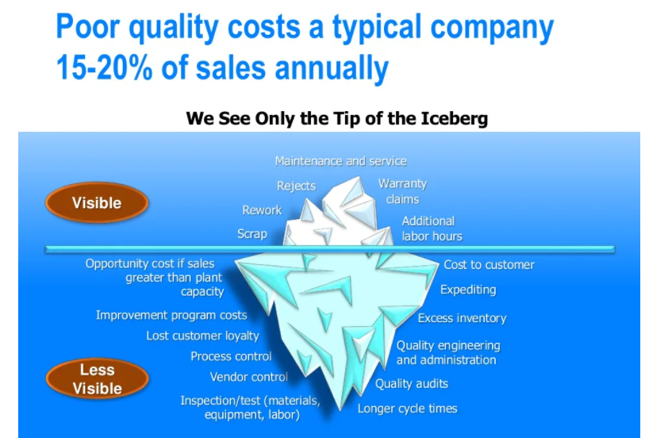

Slide 8
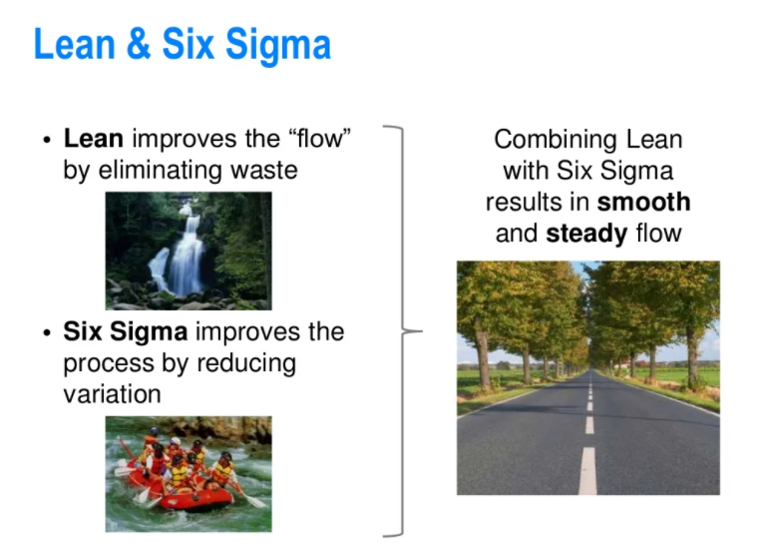

Slide 9
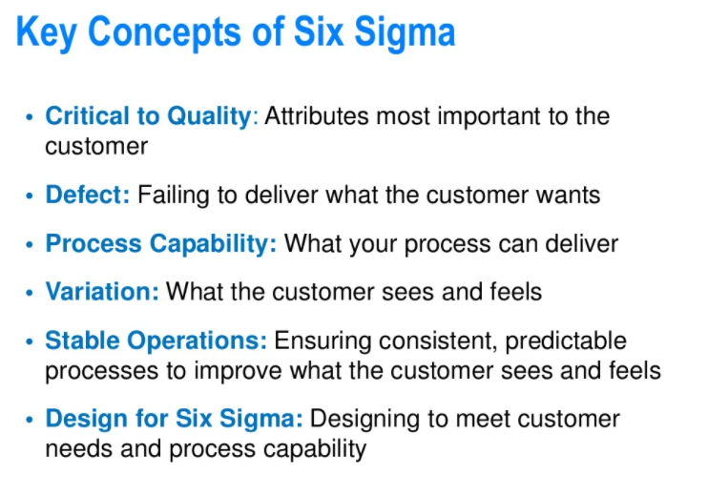

Slide 10
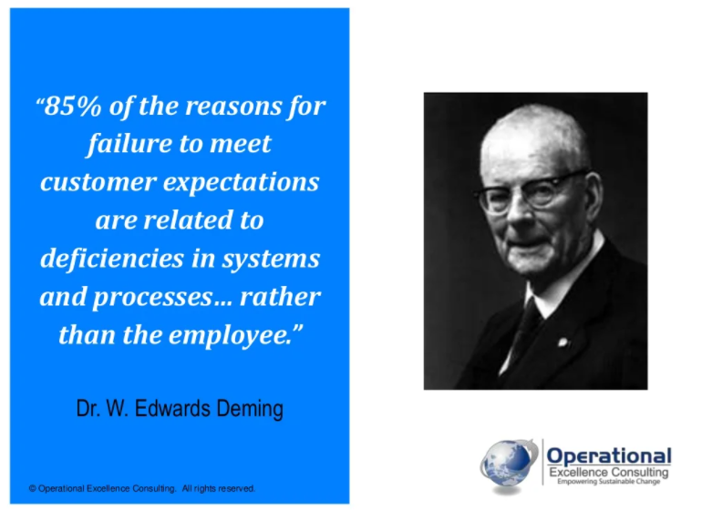

Slide 11
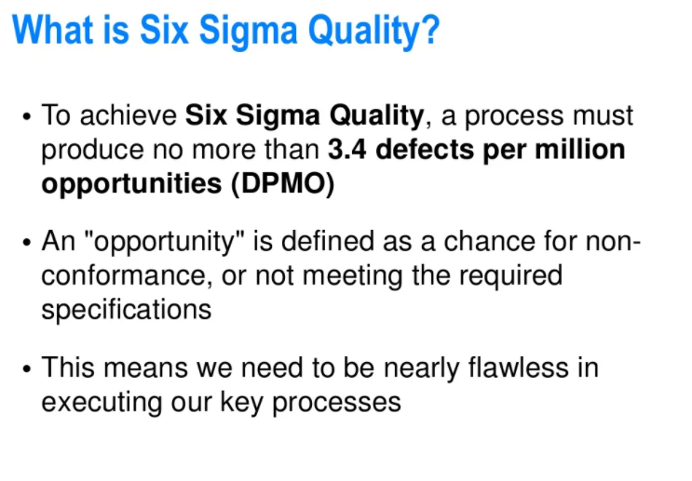

Slide 12
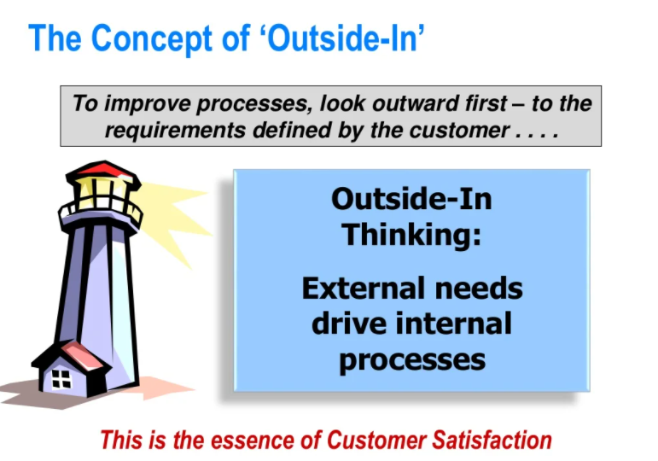

Slide 13
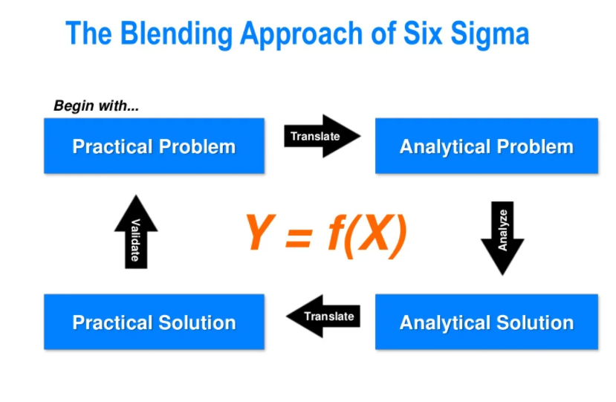

Slide 14
Six-Sigma Metrics – Measuring Defect Rate
Defects per unit (DPU) = number of defects discovered ÷ number of units produced
Defects per million opportunities (DPMO) = number of defects discovered ÷ opportunities for error × 1,000,000

Slide 15
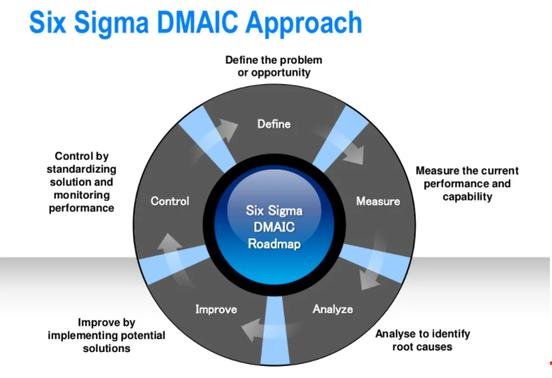

Slide 16


Slide 17


Slide 18


